Slide 1
Content Delivery Networks in Flux
Bruce Maggs
Duke University
Akamai Technologies

Slide 2
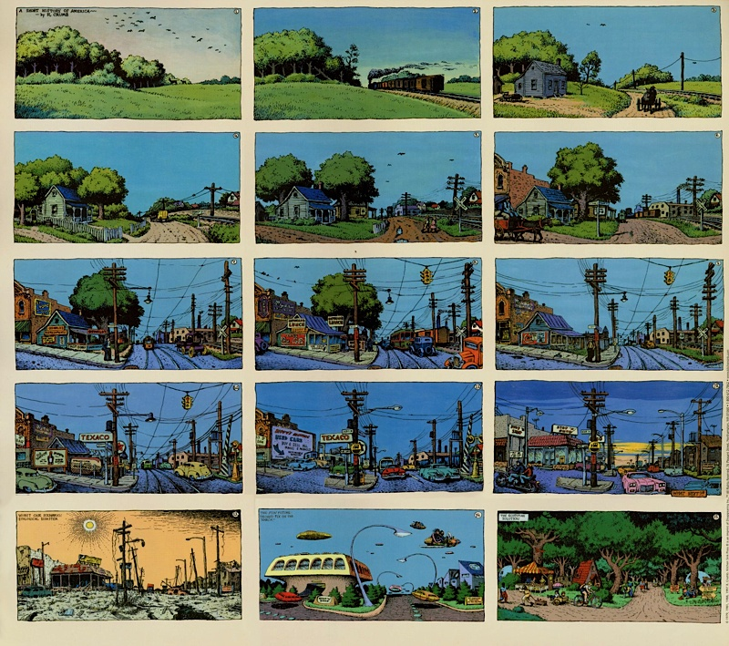
A Short History of America by R. Crumb
Client-Server
Web Hosting
Caching Hardware
Peer-to-Peer
Content-Delivery Networks
ISP-operated CDNs
Content-Provider CDNs
(Hyper Giants)
CDN Brokers
Hybrid CDNs
Licensed CDNs
Federated CDNs?
Future Internet Architectures

Slide 3
Trends
Divergence of architectures
Commoditization (e.g., video)
Longer tail in object popularity distribution

Slide 4
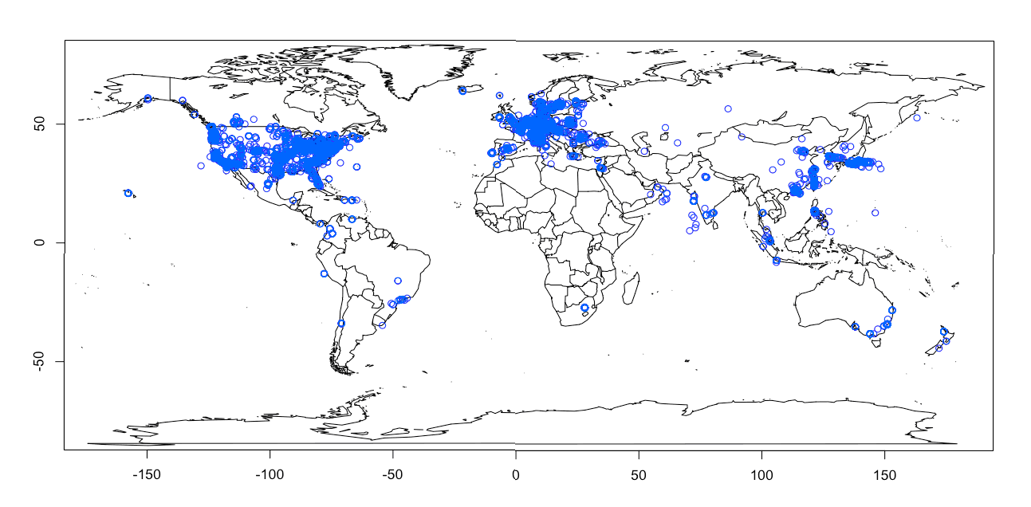
Akamai Network Deployment
127,000+ Servers
2197+ POPs
1164+ Networks
81 Countries

Slide 5
Akamai Statistics
Peak bit rate: 13.1 Tbps on 3/13/2013
Peak HTTP daily requests: 2.59 trillion on 9/23/12
560.1M unique IPv4 addresses connected to Akamai on 3/6/2012
683M in Q3 2012

Slide 6
How Big is the CDN Market?
2012 Data (Source: Bloomberg BusinessWeek)

Slide 7
Content Provider Requirements
Verifiable reliability
Access control
Invalidation
Accounting

Slide 8
High-Margin Services
Web site acceleration (latency reduction)
“Intelligence” about end users
Protection
Bells and whistles – rapid software changes

