Slide 1
MobilityFirst Project Update FIA PI Meeting, March 18-19 Part-I – Architectural Overview
Arun Venkataramani, Dipankar Raychaudhuri
Umass Amherst, Rutgers

Slide 2
From Design Goals to Current Architecture
Host + network mobility
No global root of trust
Intentional receipt
Proportional robustness
Content-awareness
Evolvability
Global name service
Name certification
Name resolution
Content storage & retrieval
Context & M2M services
Service migration
Inter-,intra-domain
routing
Computing
layer
Segmented
transport
Management
plane
Key insight: Logically centralized global name service
enhances mobility, security, and network-layer functions

Slide 3
Architecture: Global name service
Global name service
Name certification
human_readable_name → GUID
Name resolution: Auspice, DMap
“Darleen Fisher’s phone” → 1A348F76
Content storage & retrieval
Context & M2M services
self-certifying GUID = hash(public-key) permits bilateral authentication
Service migration
GUID flexibly identifies principals:
interface, device, person, group, service, network, etc.

Slide 4
Architecture: Global name service
Global name service
GUID → NA
Name certification
resolve(GUID)
Name resolution: Auspice, DMap
GUID→NA₂
GUID→NA₁
GUID→NA₁
GUID→NA₂
Content storage & retrieval
Context & M2M services
Service migration
data
NA₁
NA₂

Slide 5
Global name service: Content retrieval
Global name service
Name certification
Name resolution: Auspice, DMap
Content storage & retrieval
Context & M2M services
Service migration

Slide 6
Global name service: Content retrieval
Content CGUID → [NA₁, NA₂, … ]
Opportunistic caching + request interception
GNRS
CGUID
CGUID
get(CGUID, NA₁)
[NA₁,NA₂,…]
NA₁
CGUID
CGUID
CGUID
CGUID
NA₂
CGUID
get(CGUID)

Slide 7
Global name service: Content retrieval
Global name service
Name certification
Name resolution: Auspice, DMap
Content storage & retrieval
Context & M2M services
Service migration

Slide 8
Indirection and grouping
Indirection: GUID₁ → GUID₂
Grouping: GUID → {GUID₁, GUID₂, …, GUID_{k}}
Indirection and grouping enable context-aware services,
content mobility, and group mobility

Slide 9
Indirection + grouping: Multicast
MGUID → {T₁, T₂, …, T_{k}} (terminal networks)
MGUID → {members(MGUID) | T_{i}} (late binding)
Global name service
send_data(MGUID,T₁)
T₁
MGUID
{T₁,T₂,…,T_{k}}
T₂
send_data(MGUID,T₂)
send_data(MGUID,T₃)
T_{k}

Slide 10
Indirection+grouping: Context-awareness
At source: CAID → {T₁, T₂, …, T_{k}} // get terminal networks
At terminal n/w: CAID → {members(CAID) | T_{i}} // late binding
GUID_{i}→[T_{i},{“type”→”yellowcab”,“geo”→”Times Sq.”}]
GUID_{i}→CAID
Global name service
CAID→members(CAID)→{T₁, T₂, …, T_{k}}
send_data(CAID,T₁)
T₁
CAID
{T₁,T₂,…,T_{k}}
T₂
send_data(CAID,T₂)
send_data(CAID,T₃)
T_{k}

Slide 11
Indirection+grouping: Content directories
Moving content directory (CDID) from NA₁ to NA₂
C₁→{CDID, “name”→”nbc.com/content1”}
Global name service
CDID→NA₂
nbc.com/*
CDID→[NA₂]
NA₁
C₁
NA₂
get(C₁,NA2)
NA₂

Slide 12
Group mobility
Group GUIDs help reduce update overhead even when no actual data transfer is happening
GUID_{i}→GGUID
Global name service
GGUID→NA₂
GUID₁
NA₂
send(GUID₁,NA2)
GGUID→NA₂
NA₁
NA₂

Slide 13
From Design Goals to Current Architecture
Host + network mobility
No global root of trust
Intentional data receipt
Proportional robustness
Content-awareness
Evolvability
Global name service
Name certification
Name resolution
Content storage & retrieval
Context & M2M services
Service migration
Inter-,intra-domain
routing
Computing
layer
Segmented
transport
Management
plane
Key insight: Logically centralized global name service
enhances mobility, security, and network-layer functions

Slide 14
Architecture: Scaling interdomain routing
Function: Route to GUID@NA
Scale: Millions of NA’s ⬄ huge forwarding tables
send(GUID@NA, data)
Network | Interface
NA1 | 2
NA2 | 6
NA3 | 1
NA4 | 2
… | …
… | …
NA10⁸ | 4
…
…
…
…
NA2
…
…
NA3
…
…
…
…
…
…
…
…
NA1
…
…
…
…
…
…
Notes:
14

Slide 15
Architecture: Scaling interdomain routing
Function: Route to GUID@NA scalably
Approach: Core and edge networks to reduce state
Global name service
X1
X2
X3
GUID
X₂,T₄
[X₂,T₄]
data
T₁
T₂
T₄
T₅
T₃
T₆
GUID
Notes:
15

Slide 16
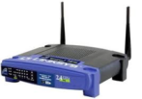
Architecture: Multihoming and multipath
Global name service: Multihomed resolution
GUID_src → {[X₃,R₁], [X₃,R₂], … ,[X₃,R_{m}]}
GUID_dst → {[X₁,T₁], [X₂,T₂], [X₁,T₂], … , [X₂,T_{k}]}
GUID_dst → {“TE_policy” → “prefer WiFi for delay-tolerant downloads”}
X1
X2
X3
T₁
T₂
T_{k}
R₁
R₂
R_{m}

Slide 17
From Design Goals to Current Architecture
Host + network mobility
No global root of trust
Intentional data receipt
Proportional robustness
Content-awareness
Evolvability
Global name service
Name certification
Name resolution
Content storage & retrieval
Context & M2M services
Service migration
Inter-,intra-domain
routing
Computing
layer
Segmented
transport
Management
plane
Key insight: Logically centralized global name service
enhances mobility, security, and network-layer functions

Slide 18
Architecture: Computing layer
Programmable computing layer enables service flexibility and evolvability
Routers support new network services off the critical path
Packets carry (optional) service tags for demuxing
Integration with “active” GUID resolution in global name service
Virtual
Service
Provider
Content
x-coding
Privacy
routing
Computing layer
CPU
Storage
Packet forwarding/routing
anon
anon
......
......

Slide 19
From Design Goals to Current Architecture
Host + network mobility
No global root of trust
Intentional data receipt
Proportional robustness
Content-awareness
Evolvability
Global name service
Name certification
Name resolution
Content storage & retrieval
Context & M2M services
Service migration
Inter-,intra-domain
routing
Computing
layer
Segmented
transport
Management
plane
Key insight: Logically centralized global name service
enhances mobility, security, and network-layer functions

Slide 20
Segmented block transport
Segment = contiguous sequence of links
Storage routers available at segment boundaries
Unit of transmission a named block = large contiguous chunk of data (not small packets as in E2E TCP)
WiFi
ISP3
ISP1
ISP2
4G
Storage
router
Block
Segment 2
Segment 1
Storage
router

Slide 21
From Design Goals to Current Architecture
Host + network mobility
No global root of trust
Intentional data receipt
Proportional robustness
Content-awareness
Evolvability
Global name service
Name certification
Name resolution
Content storage & retrieval
Context & M2M services
Service migration
Inter-,intra-domain
routing
Computing
layer
Segmented
transport
Management
plane
Key insight: Logically centralized global name service
enhances mobility, security, and network-layer functions

Slide 22
Management plane
Management plane to enable
Visibility into network performance metrics
Access-controlled querying of intradomain state
Logically centralized decision-making
Early detection and response to security problems
Client-assisted collection of management data
Data packets
Data Plane
AP
Control & Management Plane
Network
Mgmt. API

Slide 23
Architecture: Why logically centralized?
Resolution➔ Design traits ⬇ | Indirection-based | Logically-centralized | Network-layer
Intial lookup: name→location | -NA- | Nimrod, LISP, HIP, AIP, HAIR, XIA, MobilityFirst | -NA-
 |  | LNA, DOA, UIP, Codons
IP data routing | GSM/MobileIP, i3 | All | DONA, Serval
Named-data routing | i3 | Possible in LNA, DOA, UIP (or DHT schemes) | TRIAD, ROFL, DONA, CCN/NDN, Serval
Mid-session mobility | Seamless | Bilateral, falling back on name service | Seamless; Outage ≈ convergence delays
Worst-case size fwd’ing table for N names | O(#IP prefixes) | O(#IP prefixes), or O(#names/router) per-AS in XIA, MobilityFirst | No aggr: Ω(N) for constant stretch Aggr: O(#displaced IDs)
Indirection-based
Logically centralized
Network-layer

Slide 24
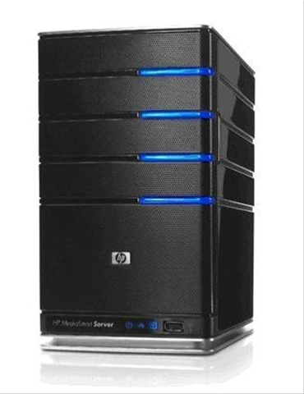
Global name service as geo-distributed key-value store
Global name service
GUID: {
{NAs:[[X₁,T₁],[X₂,T₂],…},
{geoloc:[lat, long]},
{TE_prefs: [“prefer WiFi”,…]},
{ACL: {whitelist: […]}},
…
}
resolve(GUID,…)
value(s)
resolve(GUID,…)
value(s)

Slide 25
Auspice design goals
Low response time: Replicas of each name’s resolver should be placed close to querying end-users
Low update cost: Number of resolver replicas should be limited to reduce replica consistency overhead
Load balance: Placement of replicas across all names should prevent load hotspots at any single site
Availability: Sufficient number of replicas so as to ensure availability amidst crash or malicious faults
Consistency: Each name resolver’s consistency requirements must be preserved

Slide 26
Questions?
http://mobilityfirst.cs.umass.edu
http://mobilityfirst.winlab.rutgers.edu

Slide 27
Trade-offs of traditional approaches
Replicate everything everywhere:
+ Low response times
- High update cost under mobility, load imbalance
Few primary replica plus edge caching:
+ Low update bandwidth cost
- Consistency requirements may limit caching benefits
- Load balance vs. response time trade-offs
Consistent hashing with replication
+ Good load balance
- High response times (randomization, locality at odds)
- Dynamic replication, consistency coordination, load balance

Slide 28
Auspice replica placement
Locality-aware
Load-aware

Slide 29
Auspice resolver placement engine
Replica controllers
Mapping algorithm + Paxos to compute active replica locations
X
X
X
Migrate
replicas
Load reports
Active
replicas
X
X
X
Locality-aware,
load-aware,
consistent
X
X
X
X
First request for name X
Typical request for name X to nearby active replica
End-hosts or local name servers

Slide 30
Auspice service migration (in-progress)
Paxos
Paxos
Replica controllers
create_replica(.)
shutdown_replica(.)
migrate_replica(.)
report_load(.)
Service replicas (VMs)
Sequential consistency
Lineariazability
America
Europe
Asia
Paxos
Paxos

Slide 31
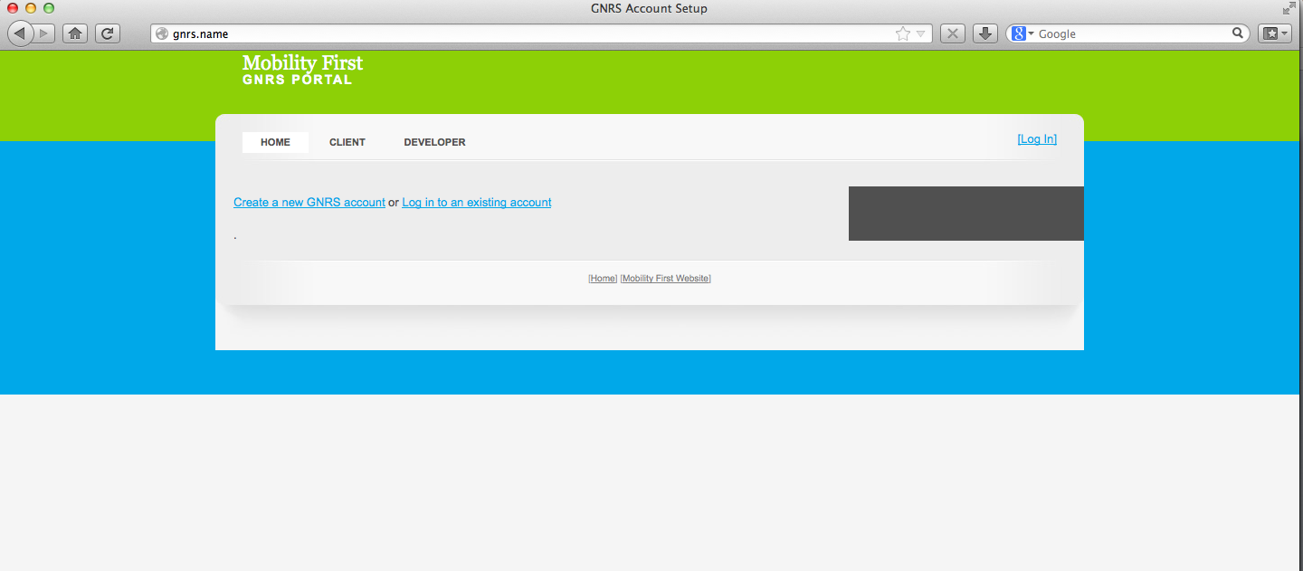
Auspice implementation & evaluation
Implemented mostly in Java (~22K lines of code)
Supports mysql, MongoDB, Cassandra, in-memory store
HTTP API for request/responses
Flexible keys and values
[GUID, NA], [GUID, IP], [name, IP]
Near-beta version deployed on eight geo-distributed Amazon EC2 locations
Extensive evaluation on larger clusters and PlanetLab settings
Mobile socket library for seamless mid-session client and server migration

Slide 32
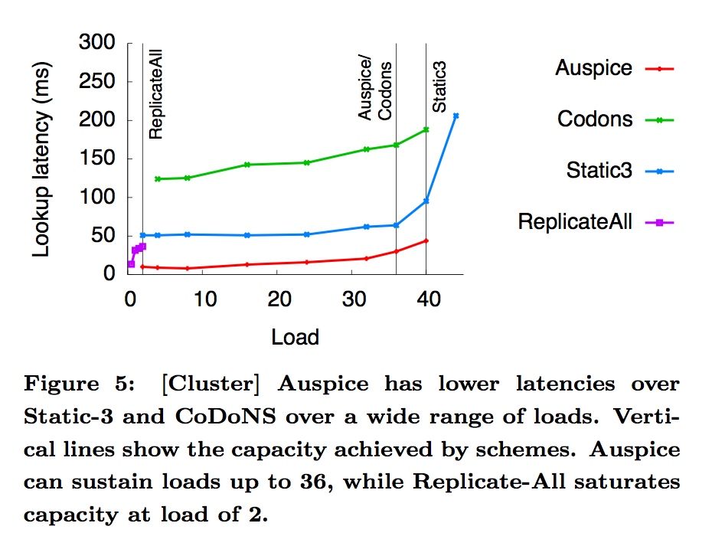
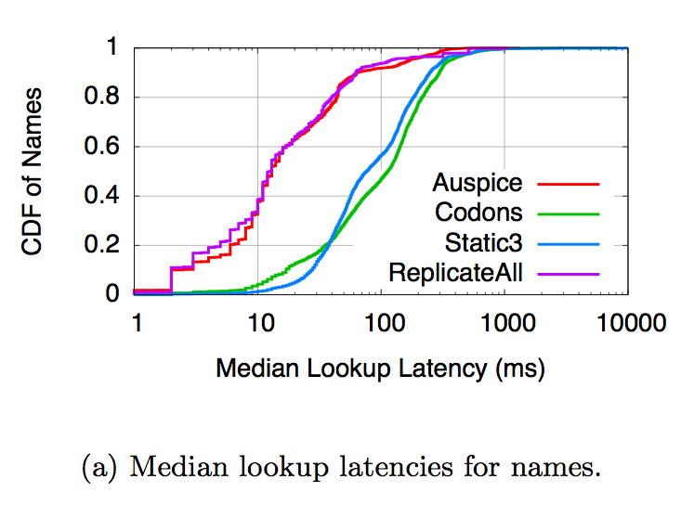
Auspice vs. alternate proposals

Slide 33
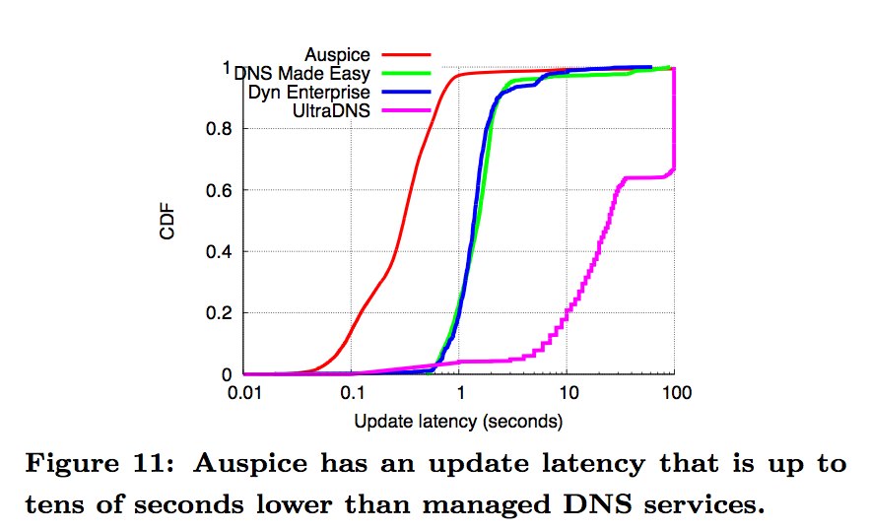
Auspice vs. commercial managed DNS

Slide 34
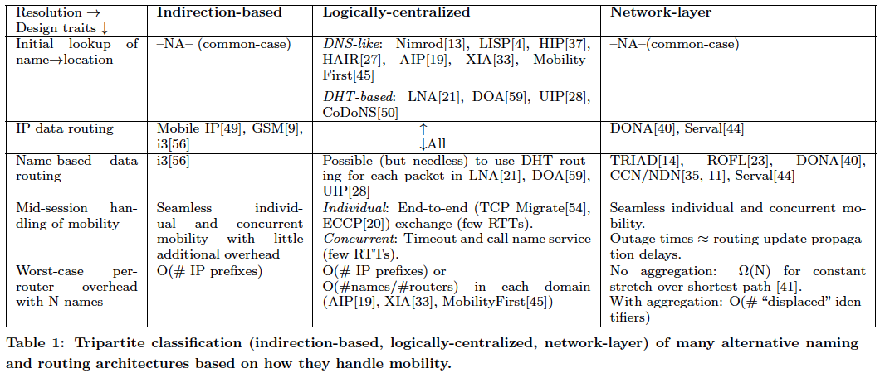
Architecture: Why logically centralized?
Indirection-based
Logically centralized
Network-layer

Slide 35
Application scenario: Emergency geo-cast
Demo by Emmanuel Cecchet
http://www.youtube.com/watch?v=tTmOArfXSsw

